Slide 1


Managing Database
And Tables with Navicat
Navicat Certified Database Administrator - Associate

Slide 2

HKIIT - Navicat Certified Database Administrator - Associate
Lessons Intended Learning Outcome
On completion of this lesson(s), students are expected to be able to:
(#1) Create a database from scratch.
(#2) Select the appropriate data types in different scenarios
(#3) Create and alter tables using Navicat's visual design tools.
(#4) Create foreign key constraints and triggers.
(#5) Manipulate data in a table using Navicat's data grid view and form view.

Slide 3
HKIIT - Navicat Certified Database Administrator - Associate
Learning Outline
Database Objects in MySQL
Terminology of relational model
Navicat’s Table Designer
Relational keys: Primary key and Foreign key
Constraints for relational integrity
Triggers in MySQL

Slide 4

HKIIT - Navicat Certified Database Administrator - Associate
COMMON TYPES
Database Objects
01
04
Tables
Functions
02
05
Triggers
Events
03
06
Views
Queries

Slide 5
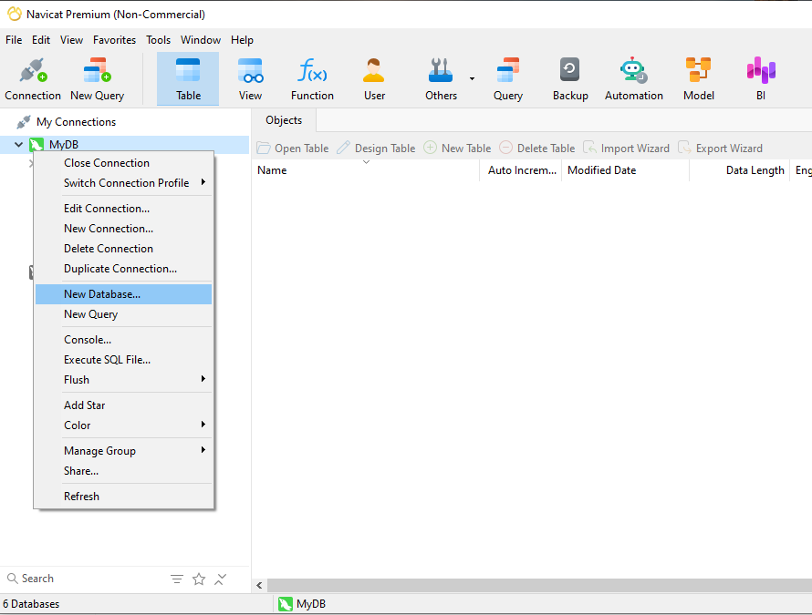
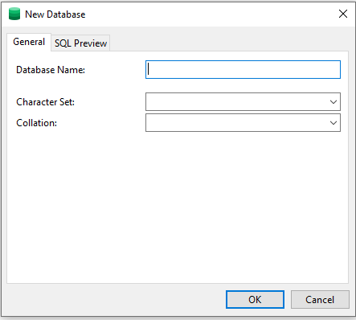

DATABASE
Creating a New Database
1.Right click
3. Enter the Database Name
(e.g. testDB)
2. Click to Create a DB
4.Finally click on OK.
HKIIT - Navicat Certified Database Administrator - Associate

Slide 6
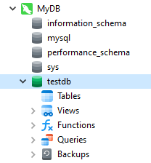
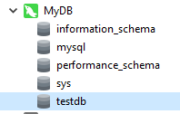
DATABASE
Connecting the Database
Double-click the database name in the navigation pane to open it.
2. Double-click the database name in the navigation pane to open it.
HKIIT - Navicat Certified Database Administrator - Associate

Slide 7
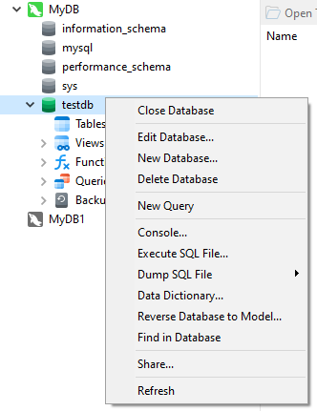
DATABASE
Disconnecting a Database
1. Click to close the connection with the database.
HKIIT - Navicat Certified Database Administrator - Associate

Slide 8
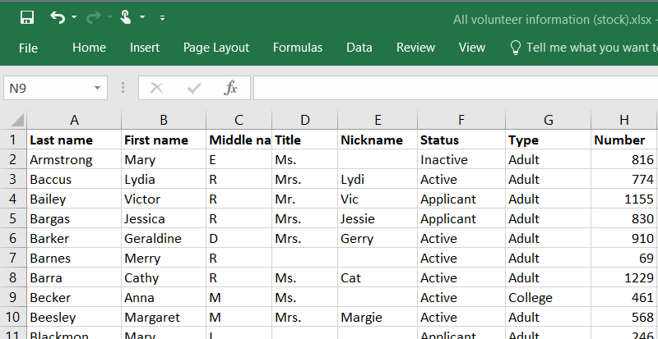
DATABASE
Table in MySQL
Think of a table like a spreadsheet where data is arranged in rows and columns.
A table is used for both storing and displaying records in the structure format.
HKIIT - Navicat Certified Database Administrator - Associate

Slide 9
DATABASE
Relational Model Terminology
Table: A table is a collection of related data organized in a grid of rows and columns.
Each table focuses on a specific subject, such as "customers," "orders," or "products.“
Columns: Columns (also known as fields) represent the attributes or properties of the data you're storing.
For example, in a "customers" table, columns might include "CustomerID," "Name," "Email," and "PhoneNumber."
Each column holds a specific type of data, like text, numbers, or dates.
Rows: Rows (also called records) represent individual entries in the table. Each row contains a unique set of data for the columns in the table.
For instance, one row in a "customers" table would store the information for a single customer, with each cell in the row holding the data for one column.
HKIIT - Navicat Certified Database Administrator - Associate

Slide 10
DATABASE
Table
Example: Imagine a table called "students" to store information about students in a school. It might look something like this:
In MySQL there are three main data types:
String (Text)
Numeric
Date and time
MySQL CREATE TABLE Statement (w3schools.com)
MySQL :: MySQL 8.4 Reference Manual :: 13 Data Types
HKIIT - Navicat Certified Database Administrator - Associate

Slide 11
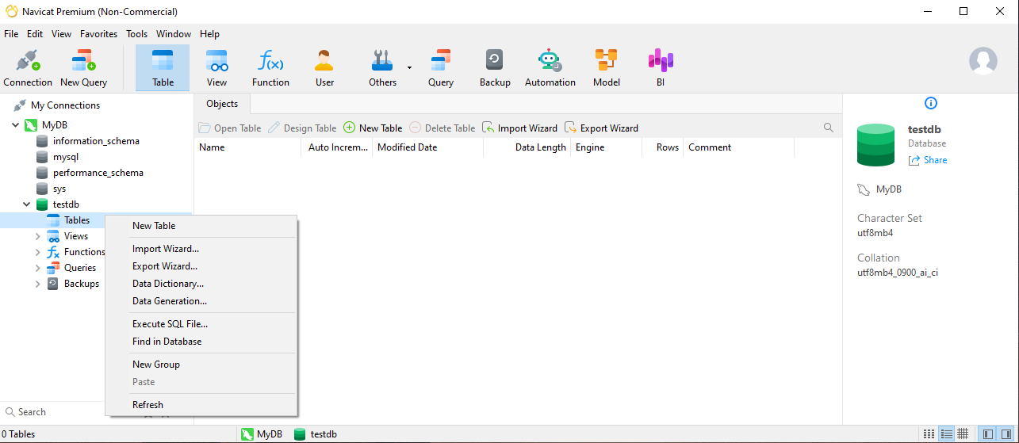
DATABASE
Creating tables with Navicat
You can click on the New Table button on the toolbar
Or right-click on Tables
Finally, select
New Table from the pop-up menu
HKIIT - Navicat Certified Database Administrator - Associate

Slide 12
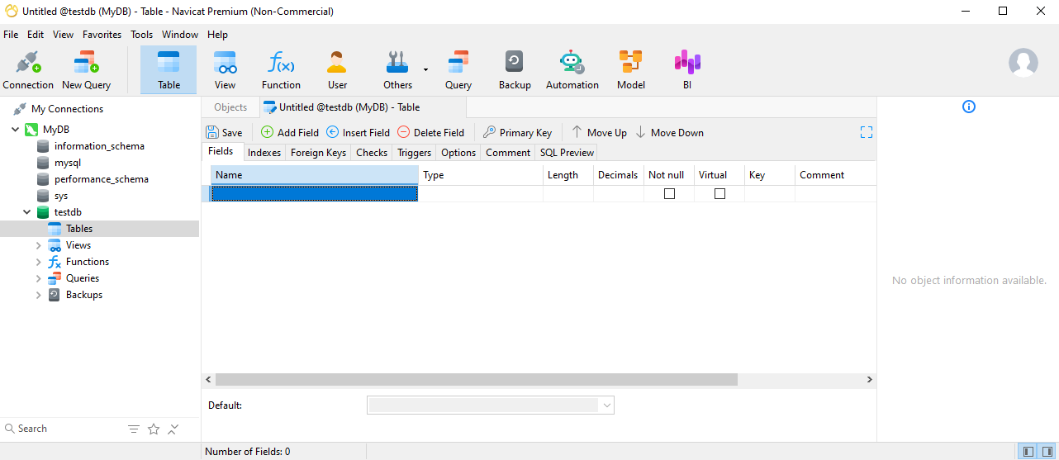
DATABASE
Navicat’s Table Designer
HKIIT - Navicat Certified Database Administrator - Associate

Slide 13
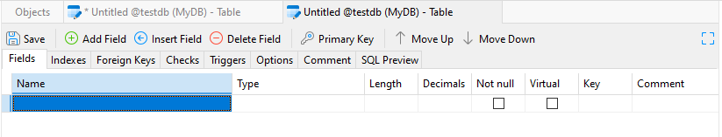
DATABASE
Navicat’s Table Designer
To reorder fields, select a field and click Move Up or Move Down on the toolbar.
Add a new field by clicking the Add Field button on the toolbar
To insert a new field between existing ones, click the desired spot and use the Insert Field button.
HKIIT - Navicat Certified Database Administrator - Associate

Slide 14



Exercise 1
DATABASE
Creating a database table to manage information about your pets
The "pets" table will act as a central repository where you can track key details about each animal.
Each animal's name
Each animal's owner
Species
Sex
Birth date
Death date
Age?
Accurate age calculations and reminders for pet birthdays.
Age changes as time passes, which means you'd have to update your records often.
HKIIT - Navicat Certified Database Administrator - Associate

Slide 15
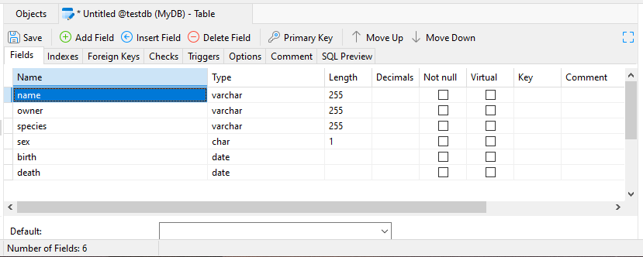
DATABASE
Exercise 1
Creating a database table to manage information about your pets
VARCHAR is a good choice for the name, owner, and species columns because the column values vary in length.
The lengths in those column definitions need not all be the same, and need not be 20.
You can normally pick any length from 1 to 65535, whatever seems most reasonable to you.
Several types of values can be chosen to represent sex in animal records, such as 'm' and 'f', or perhaps 'male' and 'female'. It is simplest to use the single characters 'm' and 'f’.
The use of the DATE data type for the birth and death columns is a fairly obvious choice
HKIIT - Navicat Certified Database Administrator - Associate

Slide 16
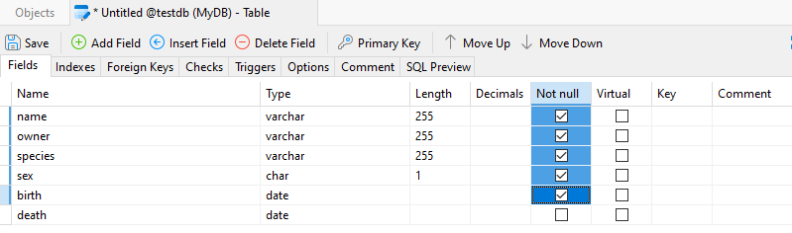
DATABASE
NOT NULL constraint
To enforces a column to NOT accept NULL values.
Check the "Not Null" checkbox
to ensure the field cannot have null values.
HKIIT - Navicat Certified Database Administrator - Associate

Slide 17
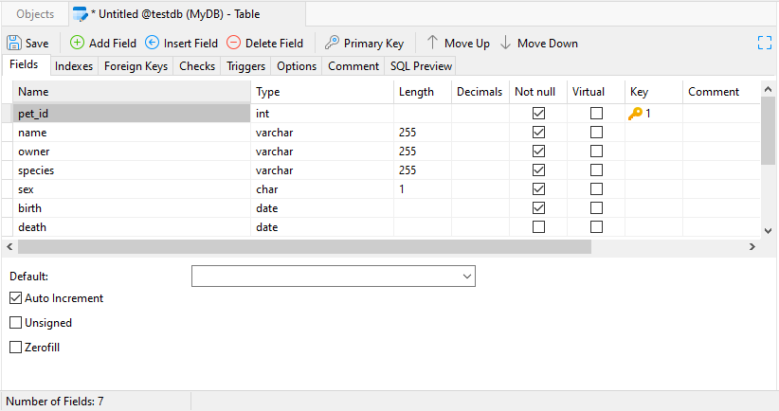
DATABASE
Primary Key
A primary key is a column with a unique value for every row.
Create a special column that uniquely identifies each pet.
To insert a new field named ‘pet_id’ before the ‘name’ field:
Select Type as INT.
Set it as the Primary Key by clicking the yellow key icon.
Finally, check the Auto Increment option at the bottom.
HKIIT - Navicat Certified Database Administrator - Associate

Slide 18
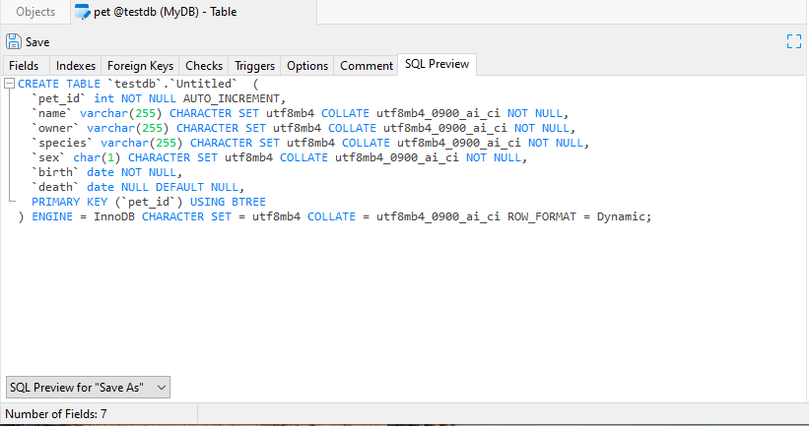
DATABASE
SQL Preview Tab
Before saving any modifications, you can switch to this tab to view the SQL code that Navicat will execute on your database server.
Save this table as ‘pet’ by clicking on one of the Save or Save As buttons on the toolbar.
HKIIT - Navicat Certified Database Administrator - Associate

Slide 19
DATABASE
Creating the table
Save this table as ‘pet’ by clicking on one of the Save or Save As buttons on the toolbar.
HKIIT - Navicat Certified Database Administrator - Associate

Slide 20
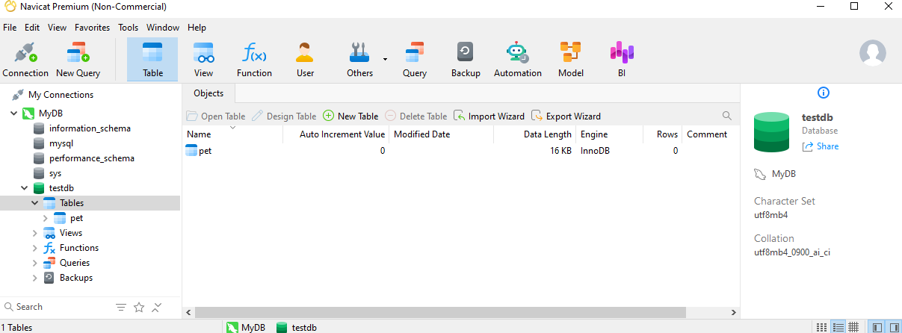
DATABASE
List all tables in the database.
HKIIT - Navicat Certified Database Administrator - Associate

Slide 21
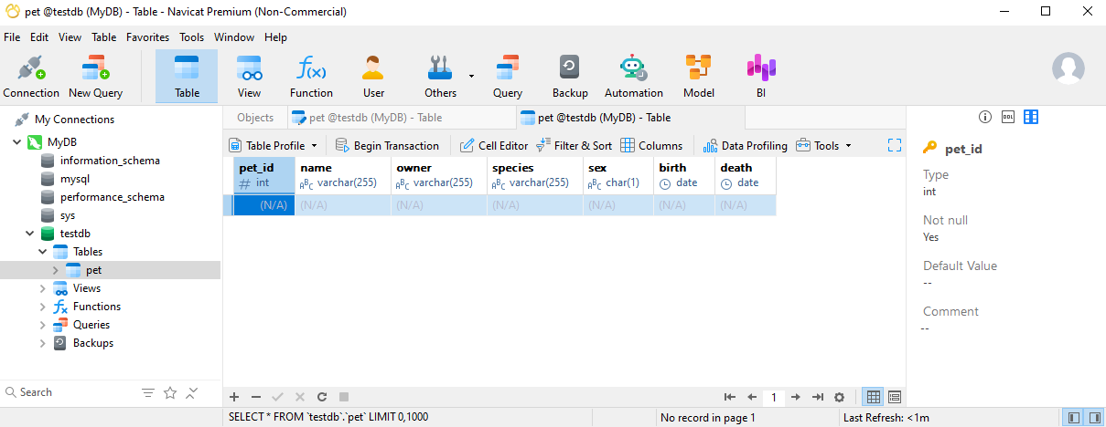
DATABASE
Enter data in table
Double-click on it
A Grid View for entering data just like you would do in a spreadsheet.
HKIIT - Navicat Certified Database Administrator - Associate

Slide 22
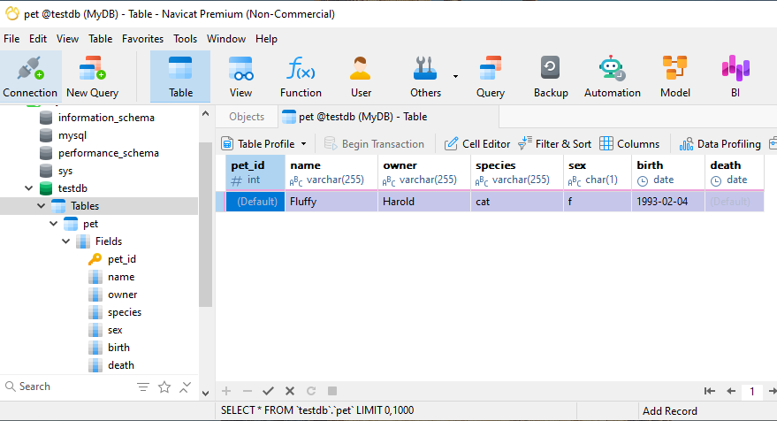
DATABASE
Enter data in table
1. Just click on a cell to start entering the data
Click to Discard Change
2. Apply Change
HKIIT - Navicat Certified Database Administrator - Associate

Slide 23
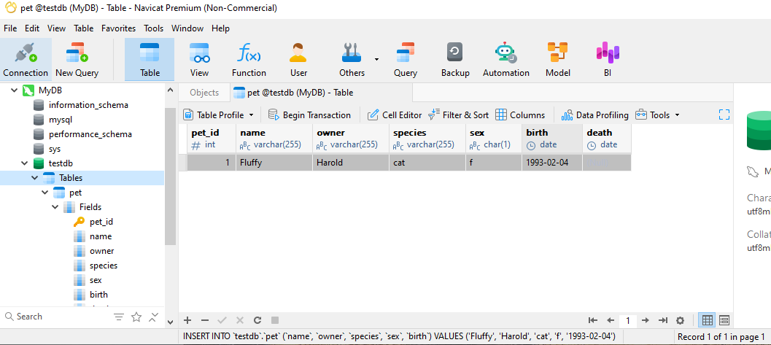
DATABASE
Enter data in table
The primary key is automatically generated.
The SQL that
Navicat executed.
HKIIT - Navicat Certified Database Administrator - Associate

Slide 24
DATABASE
Edit data in table
Add a record
Delete a record
HKIIT - Navicat Certified Database Administrator - Associate

Slide 25
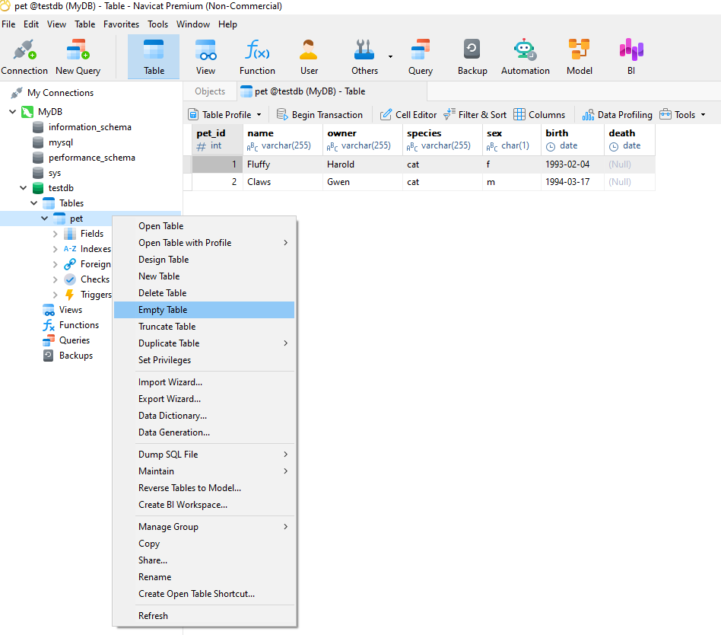
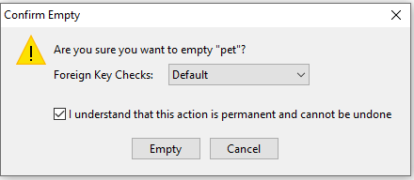
DATABASE
Empty Table
To empty a table, right-click the selected table and select Empty Table from the pop-up menu.
HKIIT - Navicat Certified Database Administrator - Associate

Slide 26
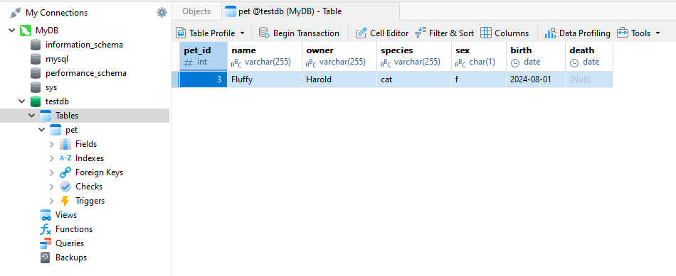
DATABASE
Empty Table
This option is only applied when you wish to
clear all the existing records without resetting the auto-increment value.
Try to insert a new record, and the pet_id is start from 3.
HKIIT - Navicat Certified Database Administrator - Associate

Slide 27
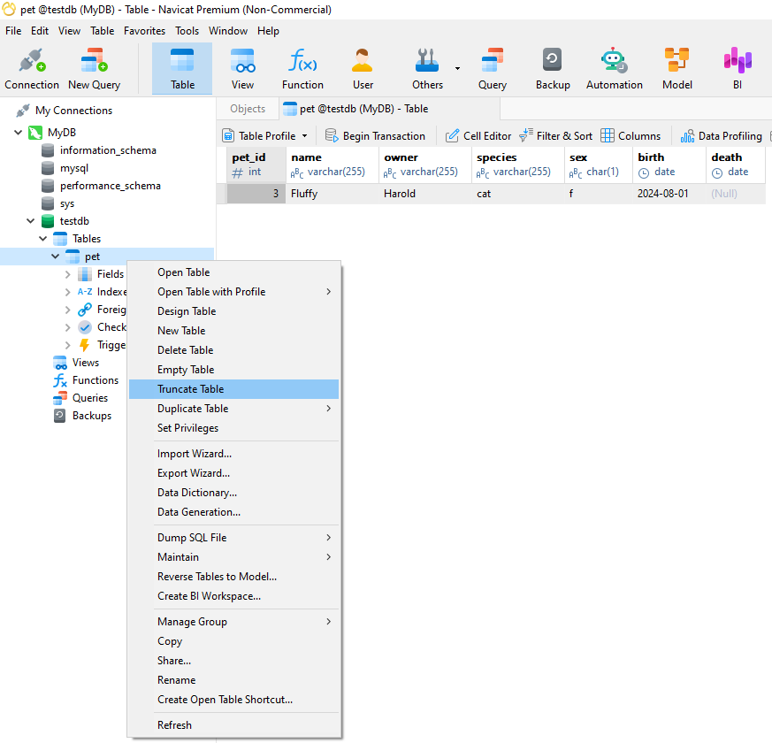
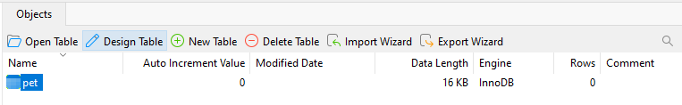
DATABASE
Truncate Table
To reset the auto-increment value while emptying your table, use Truncate Table.
HKIIT - Navicat Certified Database Administrator - Associate

Slide 28
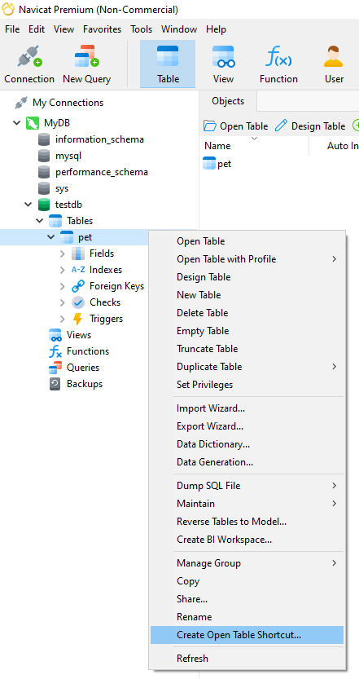
DATABASE
Create a table shortcut
It provides a convenient way for you to open your table for entering data directly without activating the Navicat main window.
Right-clicking a table in the Object pane and select Create Open Table Shortcut from the pop-up menu.
HKIIT - Navicat Certified Database Administrator - Associate

Slide 29
DATABASE
Foreign key
A FOREIGN KEY is a field in one table, that refers to the PRIMARY KEY in another table.
The table containing the foreign key is known as the child table, while the table with the primary key is referred to as the parent table.
This relationship connects the data in the two tables, ensuring that the child table's entries correspond to valid entries in the parent table.
HKIIT - Navicat Certified Database Administrator - Associate

Slide 30
DATABASE
Foreign key - Example
Owners Table
: This table lists all the people who own pets.
owner_id | owner_name | contact_info
1 | Alice | alice@example.com
2 | Bob | bob@example.com
Points to
Pets Table
pet_id | name | species | sex | birth | death | owner_id
1 | Buddy | Dog | M | 1/5/2018 |  | 1
2 | Whiskers | Cat | F | 10/6/2019 |  | 2
Foreign Key
This means:
Buddy belongs to Alice (owner_id = 1).
Whiskers belongs to Bob (owner_id = 2).
Make sure that each pet in the "Pets” table is linked to a valid owner in the "Owners Table".
HKIIT - Navicat Certified Database Administrator - Associate

Slide 31
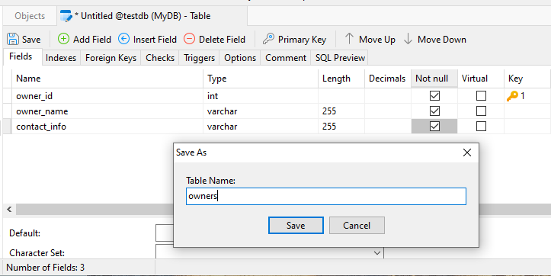
DATABASE
Exercise 2 - Foreign key
Task1: Create the Owners Table
HKIIT - Navicat Certified Database Administrator - Associate

Slide 32
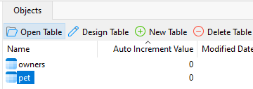
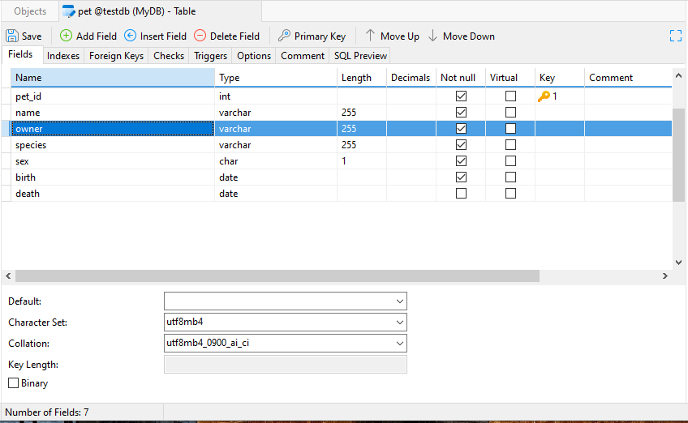
DATABASE
Exercise 2 - Foreign key
Task2: Modify the 'pets' table to establish a proper relationship with the 'owners' table using a foreign key.
1. To alter fields in tables,
open the Navicat’s Table Designer
2. Delete the ‘owner’ field
HKIIT - Navicat Certified Database Administrator - Associate

Slide 33
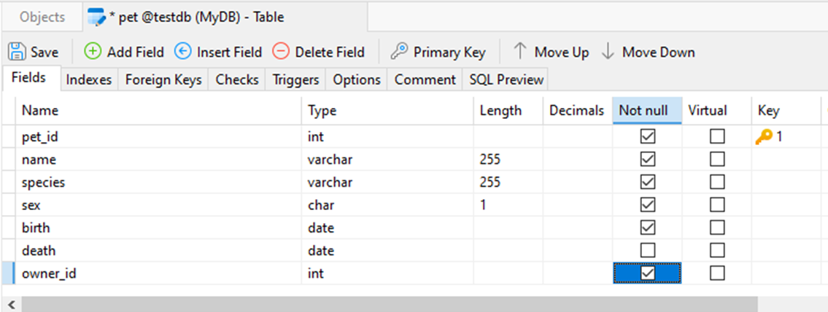
DATABASE
Exercise 2 - Foreign key
Task2: Modify the 'pets' table to establish a proper relationship with the 'owners' table using a foreign key.
3. Add a new column to reference the owner
HKIIT - Navicat Certified Database Administrator - Associate

Slide 34
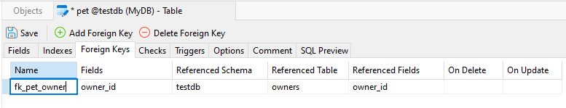
DATABASE
Exercise 2 - Foreign key
Task2: Modify the 'pets' table to establish a proper relationship with the 'owners' table using a foreign key.
Step4: Navigate to the "Foreign Keys" tab
Step5: Define Foreign Key Constraints
Step6: Save the Foreign Key Constraint
HKIIT - Navicat Certified Database Administrator - Associate

Slide 35
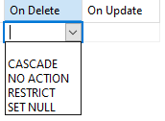
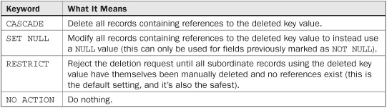
DATABASE
Foreign key - Referential Actions
MySQL :: MySQL 8.4 Reference Manual :: 15.1.20.5 Referential Actions
HKIIT - Navicat Certified Database Administrator - Associate

Slide 36
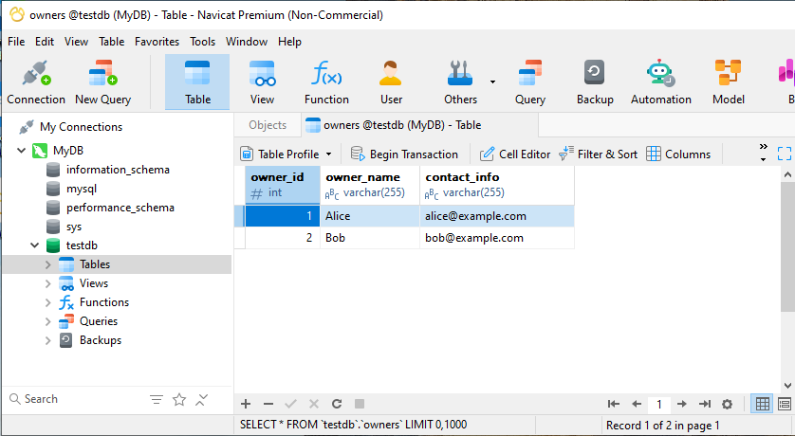
DATABASE
Exercise 2 - Foreign key
Task3: Insert records of pet owners
owner_name | contact_info
Alice | alice@example.com
Bob | bob@example.com
HKIIT - Navicat Certified Database Administrator - Associate

Slide 37
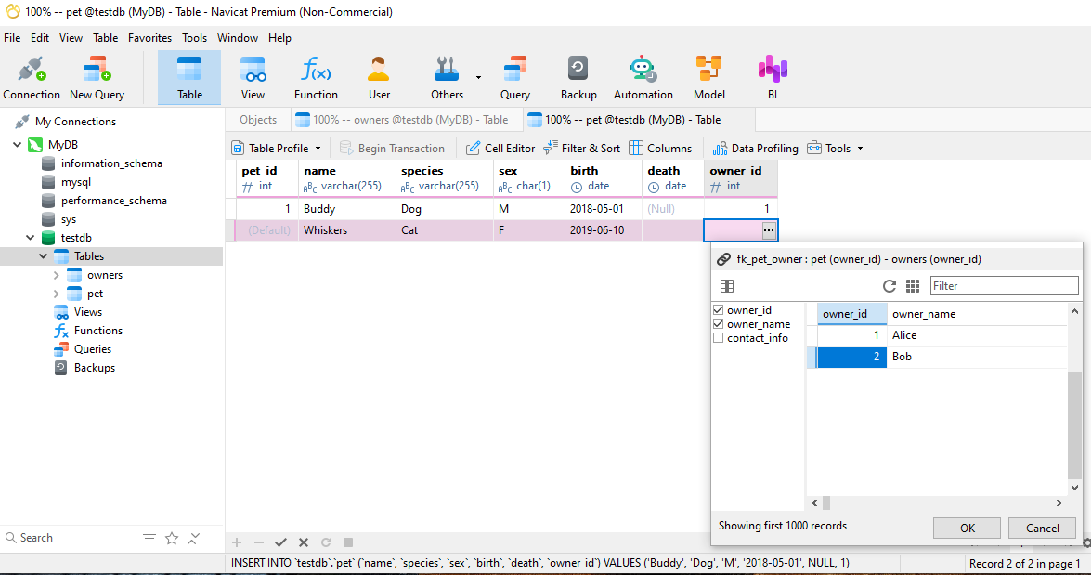
DATABASE
Exercise 2 - Foreign key
Task4: Insert record about pet and references their owners using a foreign key.
HKIIT - Navicat Certified Database Administrator - Associate

Slide 38
DATABASE
Exercise 2 - Foreign key
Task4: Insert record about pet and references their owners using a foreign key.
HKIIT - Navicat Certified Database Administrator - Associate

Slide 39
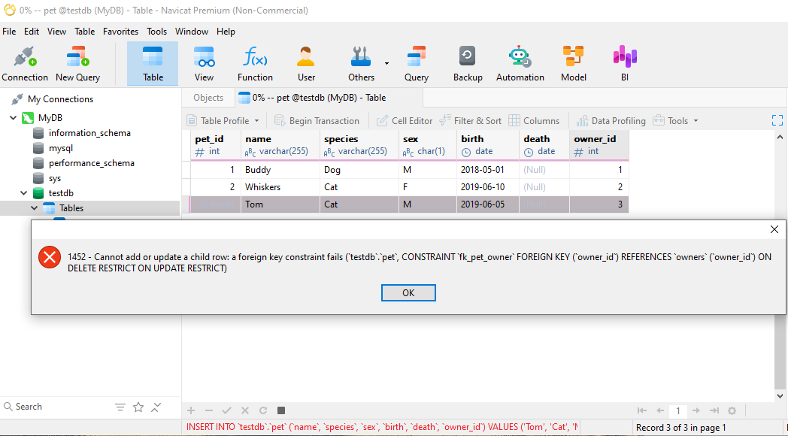
DATABASE
Exercise 2 - Foreign key
Task5: Insert a new pet record with a non-existent owner ID.
It will result in an error due to the foreign key constraint.
HKIIT - Navicat Certified Database Administrator - Associate

Slide 40
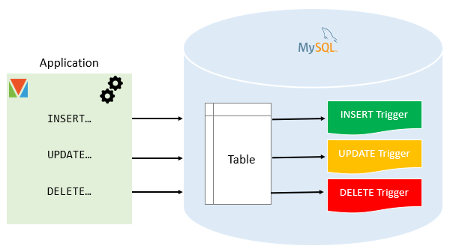
DATABASE
MySQL trigger
A MySQL trigger is a database object that is associated with a table.
A MySQL triggers can be set to run before or after events like insertions, updates, or deletions, allowing you to control or respond to changes in a table automatically.
Trigger Events:
INSERT: Adding a new row to the table.
UPDATE: Modifying existing data in a row.
DELETE: Removing a row from the table.
MySQL :: MySQL 8.4 Reference Manual :: 27.3 Using Triggers
HKIIT - Navicat Certified Database Administrator - Associate

Slide 41
DATABASE
MySQL Trigger
The syntax of the CREATE TRIGGER statement:
CREATE TRIGGER trigger_name
{BEFORE | AFTER} {INSERT | UPDATE | DELETE}
ON table_name
FOR EACH ROW
BEGIN
-- Trigger body (SQL statements)
END;
-- Source : https://www.mysqltutorial.org/create-the-first-trigger-in-mysql.aspx
HKIIT - Navicat Certified Database Administrator - Associate

Slide 42
DATABASE
MySQL trigger
Timing:
BEFORE: Trigger executes before the event (can modify data or prevent the event itself).
AFTER: Trigger executes after the event (useful for logging, cascading updates, etc.).
Functionality:
Data validation: Ensure data adheres to specific rules (e.g., minimum price, valid email format).
Auditing: Keep track of changes made to the table for record-keeping purposes.
Cascading updates: Automatically update related tables when changes occur in one table.
Custom actions: Perform any other tasks based on your application’s logic.
HKIIT - Navicat Certified Database Administrator - Associate

Slide 43
DATABASE
MySQL trigger
Considerations:
Performance:
Triggers can add overhead, so use them judiciously when other approaches might be more efficient.
Complexity:
Triggers can become complex, so write them clearly and maintain them carefully.
MySQL :: MySQL 8.4 Reference Manual :: 27.3.1 Trigger Syntax and Examples
HKIIT - Navicat Certified Database Administrator - Associate

Slide 44
DATABASE
MySQL trigger - Example
Scenario: Automatic Update of Pet Count in the Owners Table
Suppose you want to keep track of the number of pets each owner has in the "owners" table. To achieve this, you can create triggers that automatically update a ‘pet_count’ column in the "owners" table whenever a pet is added or removed.
Trigger Design: Update Pet Count on Pet Insertion or Deletion
Trigger 1 (after_pet_insert):
This trigger increases the ‘pet_count’ in the "owners" table when a new pet is added.
Trigger 2 (after_pet_delete):
This trigger decreases the ‘pet_count’ in the "owners" table when a pet is deleted.
HKIIT - Navicat Certified Database Administrator - Associate

Slide 45
DATABASE
MySQL trigger - Example
Trigger Design: Automatic Update of Pet Count in the Owners Table
Trigger 1 (after_pet_insert):
This trigger increases the ‘pet_count’ in the "owners" table when a new pet is added in pets table.
Purpose:
Automatically increments the ‘pet_count’ by 1 when a new pet is added.
Trigger Type: AFTER INSERT
Ensures the count is updated after the pet is successfully added to the "pets" table.
NEW.owner_id:
Refers to the owner_id of the newly added pet.
SQL Statement
CREATE TRIGGER after_pet_insert
AFTER INSERT ON pets
FOR EACH ROW
BEGIN
UPDATE owners
SET pet_count = pet_count + 1
WHERE owner_id = NEW.owner_id;
END;
HKIIT - Navicat Certified Database Administrator - Associate

Slide 46
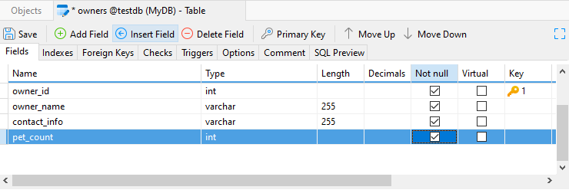
DATABASE
Step 1: Modify Owners Table Structure
Add a field ‘pet_count’ to store the number of pets each owner has in the "owners" table.
HKIIT - Navicat Certified Database Administrator - Associate

Slide 47
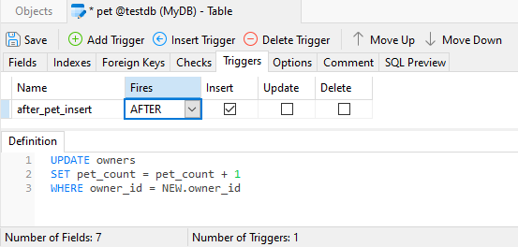
MySQL trigger
Step 2: Define a After Insert Trigger
SQL Statement
CREATE TRIGGER after_pet_insert
AFTER INSERT ON pets
FOR EACH ROW
BEGIN
UPDATE owners
SET pet_count = pet_count + 1
WHERE owner_id = NEW.owner_id;
END;
Go to the Triggers tab and click on Add Trigger from the toolbar.
Name the trigger as after_pet_insert.
In the Fires column, select After.
Check Insert and leave the other checkboxes alone.
Enter the statements code in the Definition pane
HKIIT - Navicat Certified Database Administrator - Associate

Slide 48
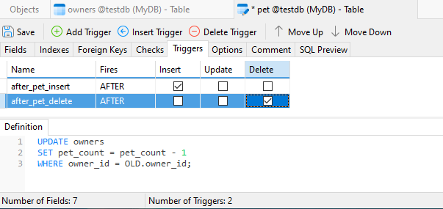
MySQL trigger
Step 3. Define a After Delete Trigger
SQL Statement
CREATE TRIGGER after_pet_delete
AFTER DELETE ON pets
FOR EACH ROW
BEGIN
UPDATE owners
SET pet_count = pet_count - 1
WHERE owner_id = OLD.owner_id;
END;
Go to the Triggers tab and click on Add Trigger from the toolbar.
Name the trigger as after_pet_delete.
In the Fires column, select After.
Check Delete and leave the other checkboxes alone.
Enter the statements code in the Definition pane
HKIIT - Navicat Certified Database Administrator - Associate

Slide 49
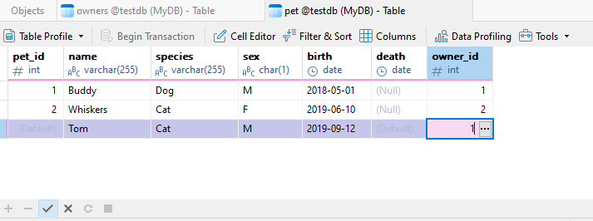
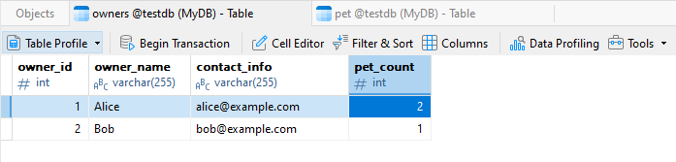
DATABASE
Testing Defined Triggers
Truncate the ‘pet’ Table to remove all record
Insert some pet records into ‘pet’ table
Switch to owners Table tab and Refresh it
Check the Pet Count in the Owners Table
Delete a pet record in ‘pet’ table
Check again for the Pet Count in the Owners Table
HKIIT - Navicat Certified Database Administrator - Associate

Slide 50
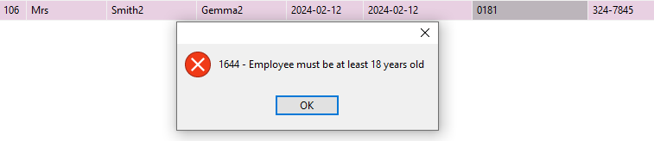
DATABASE
Trigger Throw error message
CREATE TRIGGER BeforeInsertEmployee
BEFORE INSERT ON EMPLOYEE
FOR EACH ROW
BEGIN
IF YEAR(CURDATE()) - YEAR(NEW.EMP_DOB) < 18 THEN
SIGNAL SQLSTATE '45000'
SET MESSAGE_TEXT = 'Employee must be at least 18 years old';
END IF;
END
MySQL :: MySQL 8.4 Reference Manual :: 15.6.7.5 SIGNAL Statement
HKIIT - Navicat Certified Database Administrator - Associate

Slide 51

Navicat
Managing Databases and Tables
We have covered a wide range of database features using Navicat, focusing on how to create and manage database objects through its visual tools. We now know how to use Navicat's GUI to create a database, perform its initial setup, manage database objects like tables, and define foreign key constraints and triggers.
HKIIT - Navicat Certified Database Administrator - Associate

